Slide 1
Python : Visualization
Pandas Visualizaiton
Matplotlib
Seaborn
ggplot

Slide 2

Visualization
Pandas
Matplotlib
Seaborn
Ggplot
Statistical Graphs

Slide 3
Lesson Objectives
Learn about Python Visualization
Many different packages and options.

Slide 5
Lesson Objectives
Learn about Python visualization
Introduction to different packages and available options
pandas
matplotlib
seaborn
ggplot
Comparison on a few statistical graphs

Slide 6
Pandas Visualization
➔ Pandas
Matplotlib
Seaborn
ggplot

Slide 7
Pandas
Pandas
Matplotlib
Seaborn
Ggplot
Statistical Graphs

Slide 8
Pandas Visualization
Pandas has built–in visualization.
Basically aliases similar functionality in matplotlib
Good for representing plots of dataframes
Can do things like add labels, etc through matplotlib.pyplot

Slide 9
Pandas visualization
“pandas” has built–in visualization.
Basically aliases similar functionality in matplotlib
Good for representing plots of dataframes
Can do things like add labels, etc through matplotlib.pyplot
“pandas” website - https://pandas.pydata.org/pandas-docs/stable/visualization.html

Slide 10
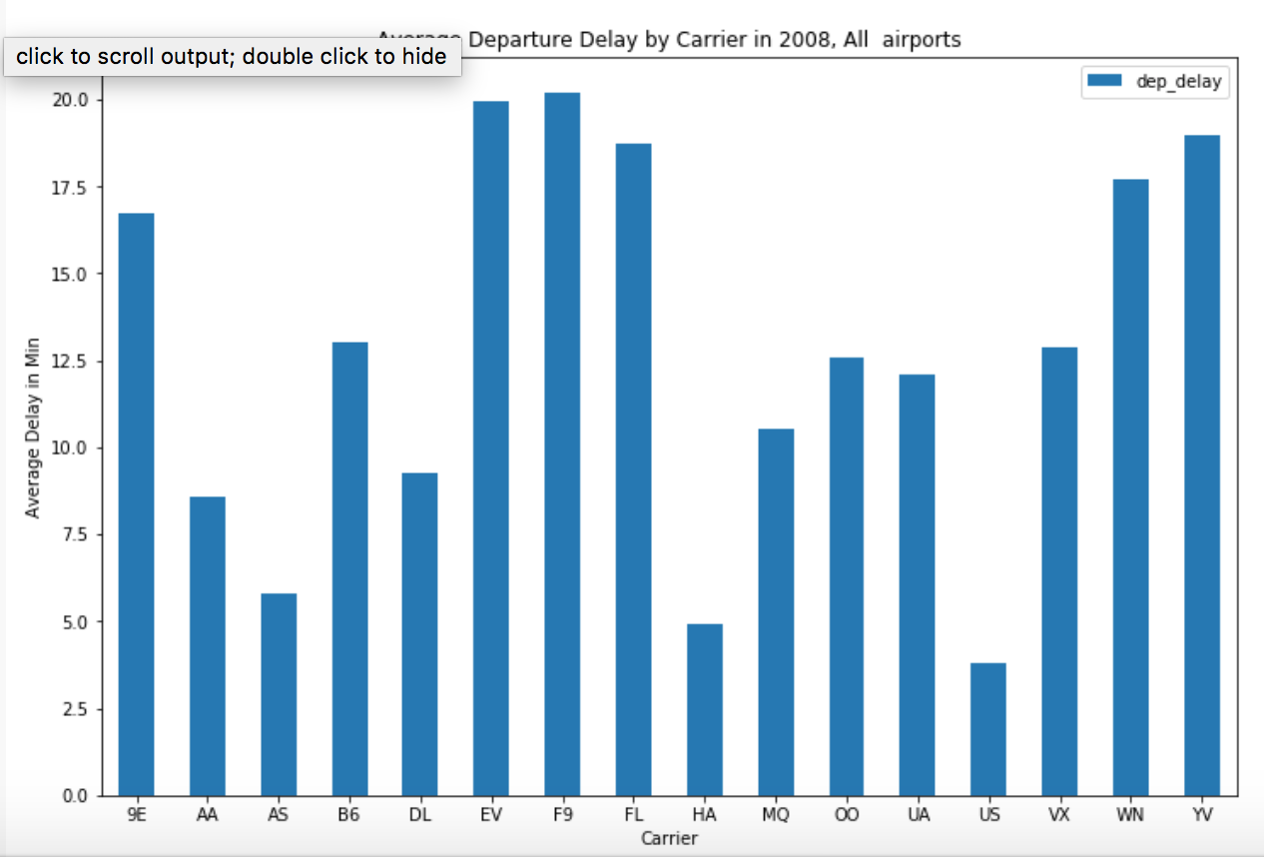
Pandas Bar plot
df.groupby('carrier').mean().plot(kind='bar', figsize =(12,8))
plt.xticks(rotation=0)
plt.xlabel('Carrier’)
plt.ylabel(‘Delay’)
plt.title('Average Arrival Delay')

Slide 11
Pandas visualization
>>> df.groupby('carrier').mean().plot(kind='bar', figsize =(12,8))
>>> plt.xticks(rotation=0)
>>> plt.xlabel('Carrier’)
>>> plt.ylabel(‘Delay’)
>>> plt.title('Average Arrival Delay')

Slide 12
Matplotlib
➔ Matplotlib
Seaborn
ggplot2

Slide 13
Matplotlib
Pandas
Matplotlib
Seaborn
Ggplot
Statistical Graphs

Slide 14
Matplotlib
Matplotlib is python’s native plotting library
Powerful, with lots of options
Not necessarily focused on aesthetics
Import like this:
To show inside jupyter
Saving to file
import matplotlib.pyplot as plt
%matplotlib inline%
plt.savefig(‘test.png’)

Slide 15
Performing and Showing plot
Call plot on the items you want to plot
You can show the plot in a external window:
plt.plot(x, y) # Pass in ndarrays that you want to plot
plt.show()

Slide 16
Matplotlib plots
“matplotlib” is python’s native plotting library
It is powerful, with lots of options, not focused on aesthetics
“matplotlib” website - https://matplotlib.org/
“matplotlib” needs to be imported
Plotting data in “x”, “y”
To show plots
Saving plots to a file
To show plots inside jupyter notebooks without explicit calls
>>> import matplotlib.pyplot as plt
>>> plt.plot(x, y)
>>> plt.show()
>>> plt.savefig(“test.png”)
>>> %matplotlib inline%

Slide 17
Plot labels and options
plt.xlabel : Label on x-axis
plt.ylabel : Label on y-axis
plt.title : Title on plot
plt.grid = true # Start grid

Slide 18
Matplotlib plot options
To set x axis label
plt.xlabel(“<x label>”)
To set y axis label
plt.ylabel(“<y label>”)
To set title on plot
plt.title(“<title>”)
To turn grid on/off plot
plt.grid(<True/False>)

Slide 19
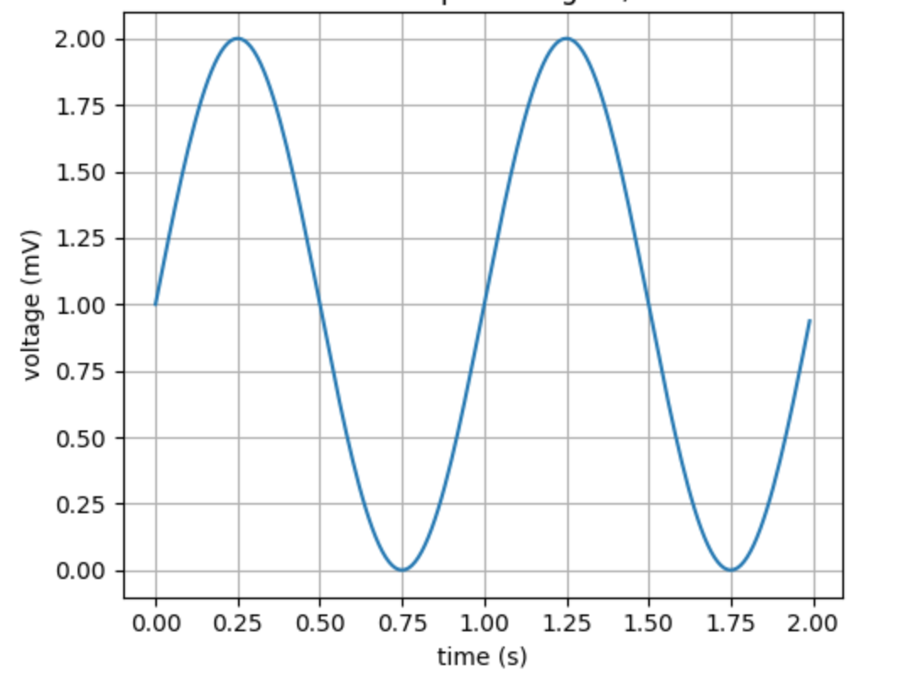
Matplotlib Simple Example
t = np.arange(0.0, 2.0, 0.01)
s = 1 + np.sin(2*np.pi*t)
plt.plot(t, s)
plt.xlabel('time (s)’)
plt.ylabel('voltage (mV)’)
plt.title(‘Sine wave’)
plt.grid(True)
plt.savefig("test.png")

Slide 20
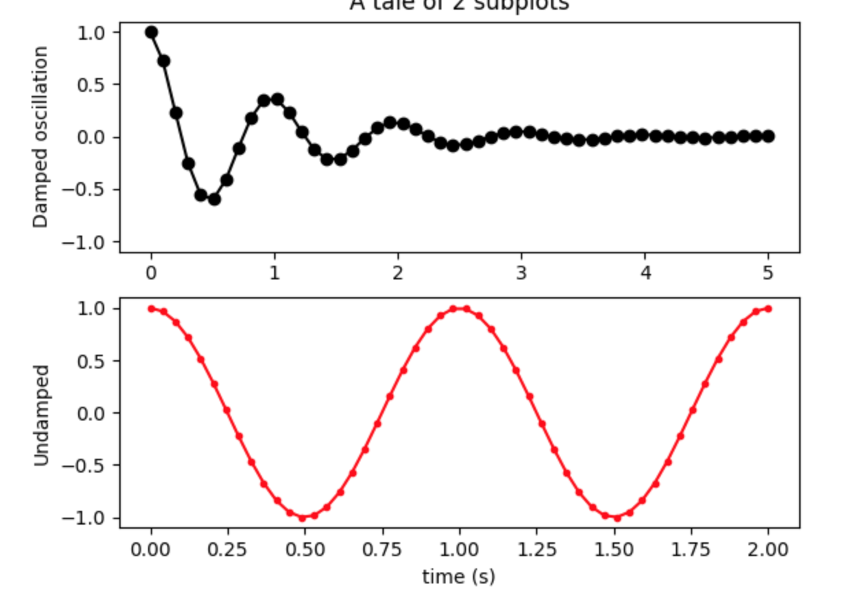
Matplotlib subplots
Matplotlib allows us to create subplots
# Create two subplots sharing y axis
fig, (ax1, ax2) = plt.subplots(2, sharey=True)
ax1.plot(x1, y1, 'ko-')
ax2.plot(x2, y2, 'r.-')
ax2.set(xlabel='time (s)', ylabel='Undamped')

Slide 21
Figure Versus Axes
The figure object is the entire plot
Typically used if we want to save the figure
The axes represent the plots
We can have more than one (subplots)
Here’s how we get one:
More than one (subplots)
import matplotlib.pyplot as plt
fig,ax = plt.subplots() # Just one plot
import matplotlib.pyplot as plt
fig, (ax1,ax2) = plt.subplots(2) #Two subplots

Slide 22
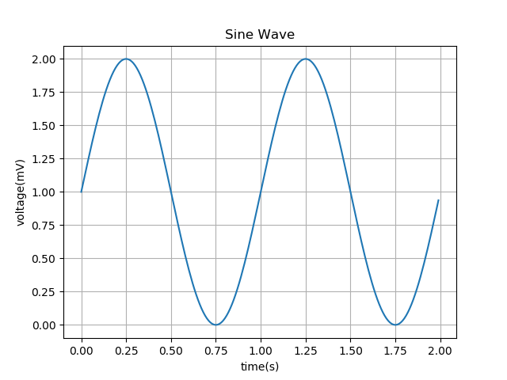
Matplotlib – plot()
Voltage vs Time using plot():
import matplotlib.pyplot as plt
import numpy as np
t = np.arange(0.0, 2.0, 0.01)
s = 1 + np.sin(2*np.pi*t)
plt.plot(t, s)
plt.xlabel('time (s)’)
plt.ylabel('voltage (mV)’)
plt.title(‘Sine wave’)
plt.grid(True)
plt.savefig("test.png")

Slide 23
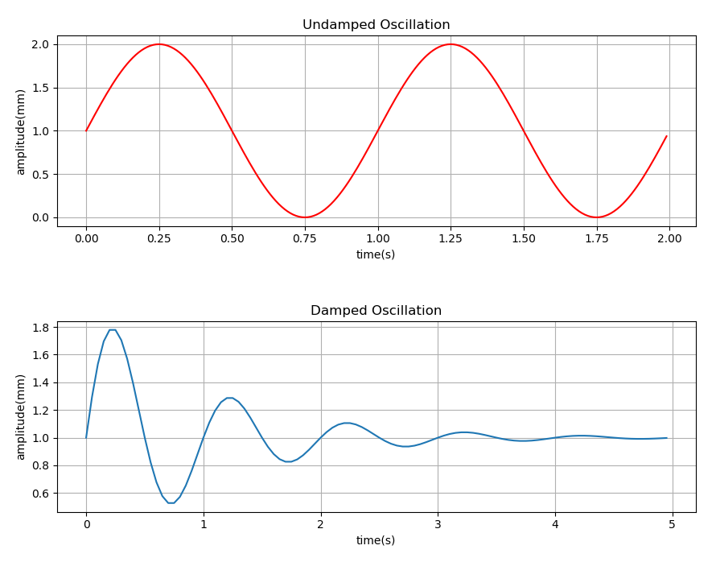
Matplotlib – subplot()
Undamped vs Damped oscillations using subplot():
import matplotlib.pyplot as plt
import numpy as np
x1 = np.arange(0, 2, 0.01)
x2 = np.arange(0, 5, 0.05)
y1 = 1 + np.sin(2 * np.pi * x1)
y2 = 1 + np.multiply(np.exp(-x2), np.sin(2 * np.pi * x2))
plt.figure(num = 1, figsize=(10.24,7.68))
plt.subplots_adjust(wspace = 0.3, hspace = 0.5)
plt.subplot(2,1,1)
plt.plot(x1, y1, color = "r")
plt.xlabel("time(s)")
plt.ylabel("amplitude(mm)")
plt.title("Undamped Oscillation")
plt.grid(True)
plt.subplot(2,1,2)
plt.plot(x2, y2)
plt.xlabel("time(s)")
plt.ylabel("amplitude(mm)")
plt.title("Damped Oscillation")
plt.grid(True)
plt.savefig("matplotlib2.png")
plt.show()

Slide 24
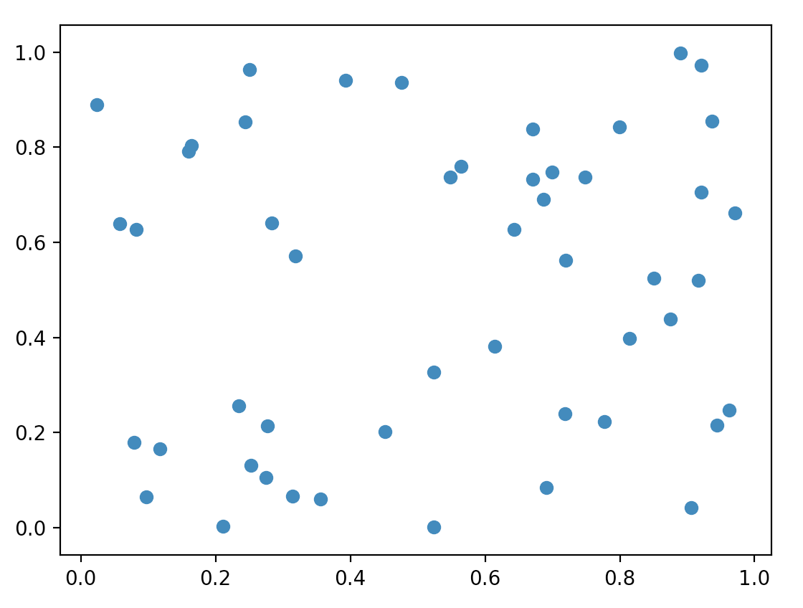
Matplotlib – scatter()
Random numbers using scatter():
import numpy as np
import matplotlib.pyplot as plt
np.random.seed(23238023)
p = 50
x = np.random.rand(p)
y = np.random.rand(p)
# colors = np.random.rand(p)
# area = (30 * np.random.rand(p))**2
plt.scatter(x, y)
# plt.scatter(x, y, s=area, c=colors, alpha=0.5)
plt.show()

Slide 25
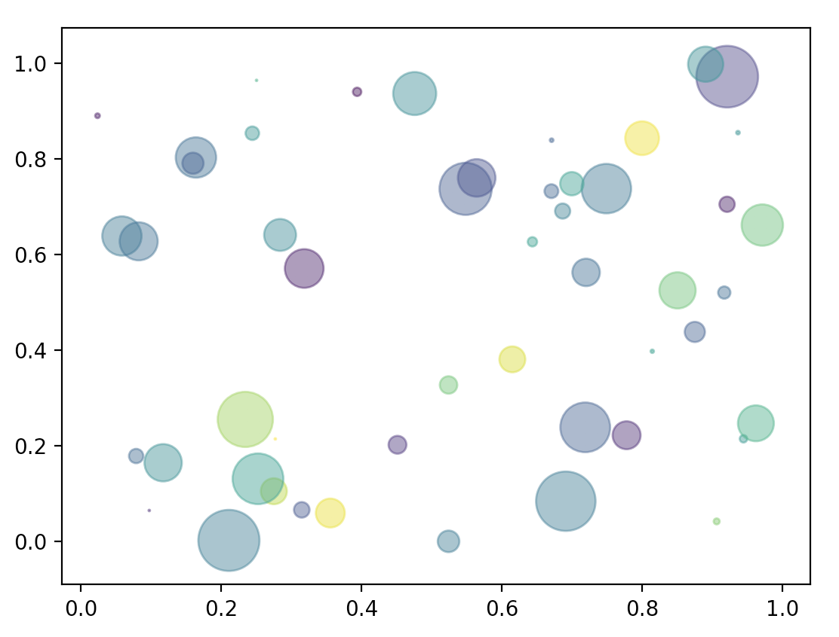
Matplotlib – scatter()
Random numbers using scatter():
Now, notice the difference in the scatter plot (looks better)
import numpy as np
import matplotlib.pyplot as plt
np.random.seed(23238023)
p = 50
x = np.random.rand(p)
y = np.random.rand(p)
colors = np.random.rand(p)
area = (30 * np.random.rand(p))**2
# plt.scatter(x, y)
plt.scatter(x, y, s=area, c=colors, alpha=0.5)
plt.show()

Slide 26
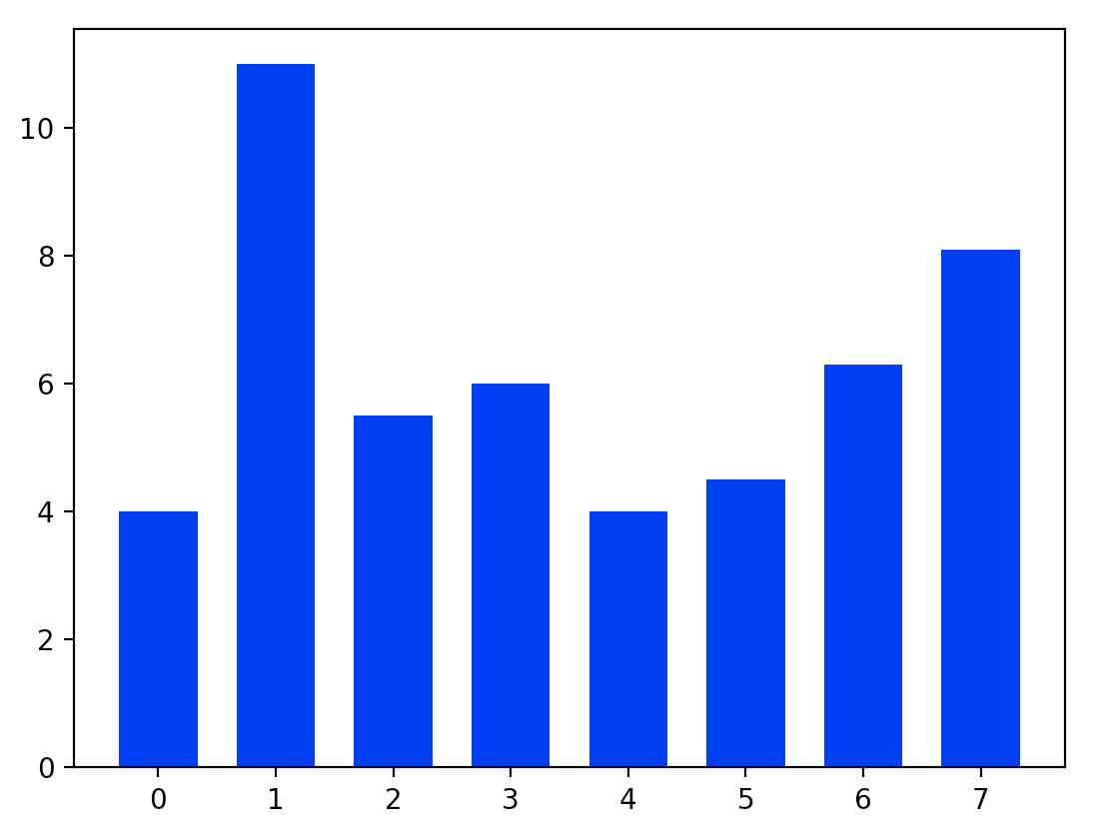
Matplotlib – bar()
Random numbers using scatter():
import matplotlib.pyplot as plt
y = [4, 11, 5.5, 6, 4, 4.5, 6.3, 8.1]
N = len(y)
x = range(N)
width = 1/1.5
plt.bar(x, y, width, color="blue")
plt.show()

Slide 27
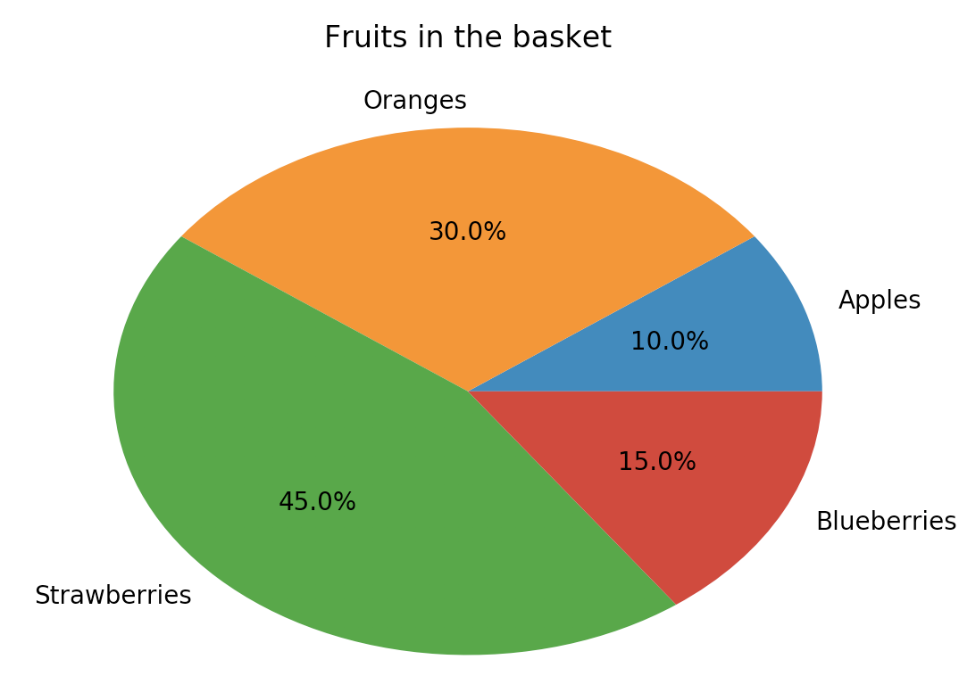
Matplotlib – pie()
Random numbers using scatter():
import matplotlib.pyplot as plt
labels = 'Apples', 'Oranges', 'Strawberries', 'Blueberries'
fracs = [10, 30, 45, 15]
plt.pie(fracs, labels=labels, autopct="%1.1f%%")
plt.title(“Fruits in the basket”) plt.show()

Slide 28
Seaborn
Pandas
Matplotlib
➔ Seaborn
ggplot

Slide 29
Seaborn
Pandas
Matplotlib
Seaborn
Ggplot
Statistical Graphs

Slide 30
Seaborn: pretty graphs
Matplotlib graphs are powerful but not very beautiful.
Seaborn makes some pretty plots
Based on Matplotlib
Allows a number of aesthetic parametres.

Slide 31
Seaborn pretty plots
“matplotlib” graphs are powerful but not very beautiful
“seaborn” makes some pretty plots
It is based on “matplotlib”
It allows a number of aesthetic parameters
“seaborn” website - https://seaborn.pydata.org/
“seaborn” needs to be imported
>>> import seaborn as sns

Slide 32
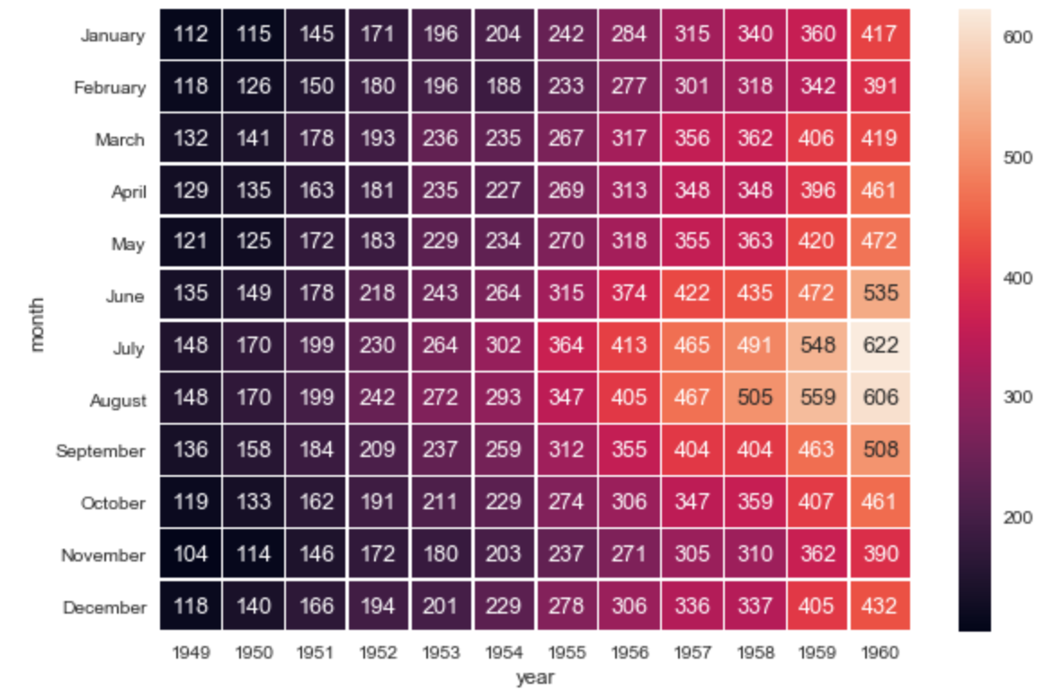
Seaborn – heatmap()
Data Matrix example:
import matplotlib.pyplot as plt
import seaborn as sns
sns.set()
f, ax = plt.subplots(figsize=(9, 6))
sns.heatmap(flights, annot=True, fmt="d", linewidths=.5, ax=ax)

Slide 33
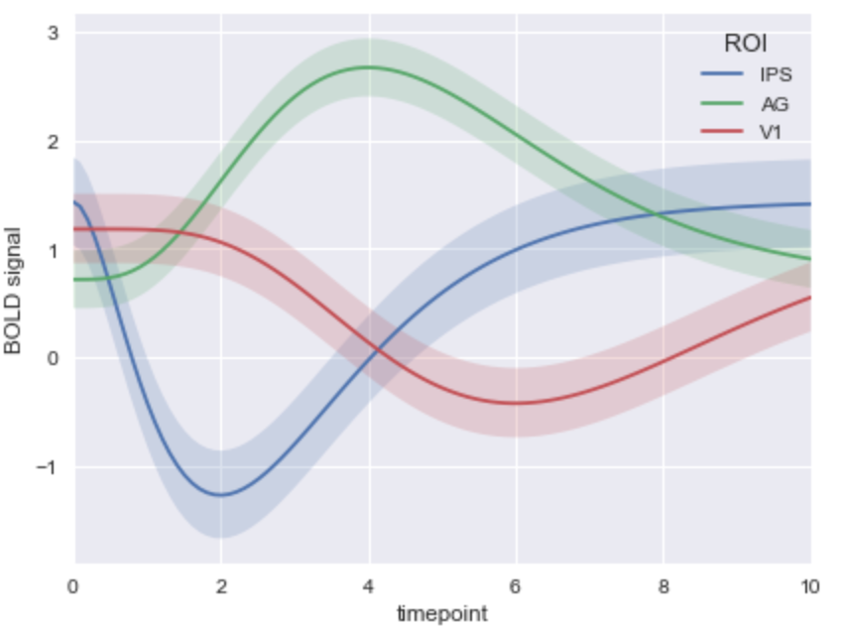
Seaborn – tsplot()
Time Series example:
import matplotlib.pyplot as plt
import seaborn as sns
sns.set()
sns.tsplot(data=gammas, time="timepoint", unit="subject”
condition="ROI", value="BOLD signal")

Slide 34
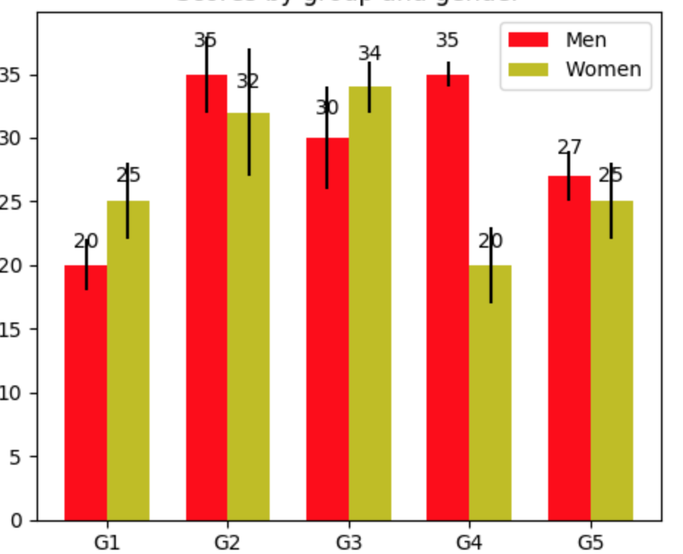
Seaborn – barplot() - Ease of use
Bar plot example – comparison of matplotlib / seaborn code
Lengthier code in matplotlib
fig, ax = plt.subplots()
rects1 = ax.bar(ind, men_means, width, color='r’,yerr=men_std)
rects2 = ax.bar(ind + width, women_means, width, color='y’, yerr=women_std)
ax.set_xticks(ind + width / 2)
ax.legend((rects1[0], rects2[0]), ('Men', 'Women'))

Slide 35
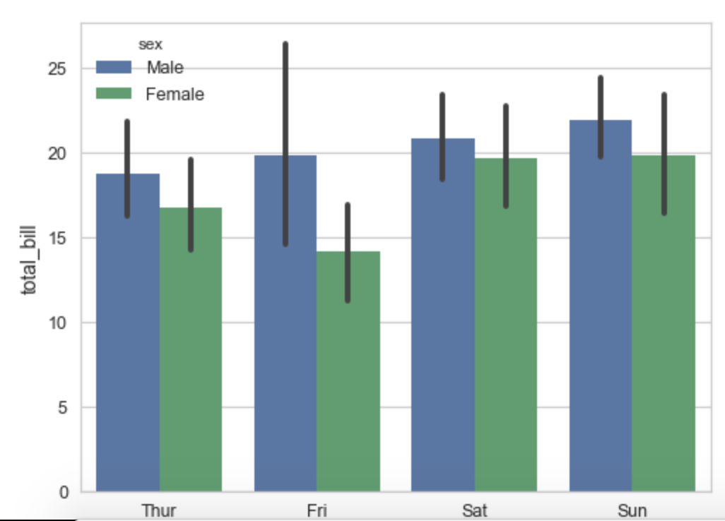
Seaborn – barplot() - Ease of use
Bar plot example – comparison of matplotlib / seaborn code
Condensed shorter code in seaborn for the same plot
ax = sns.barplot(x="day", y="total_bill", hue="sex", data=tips)

Slide 36
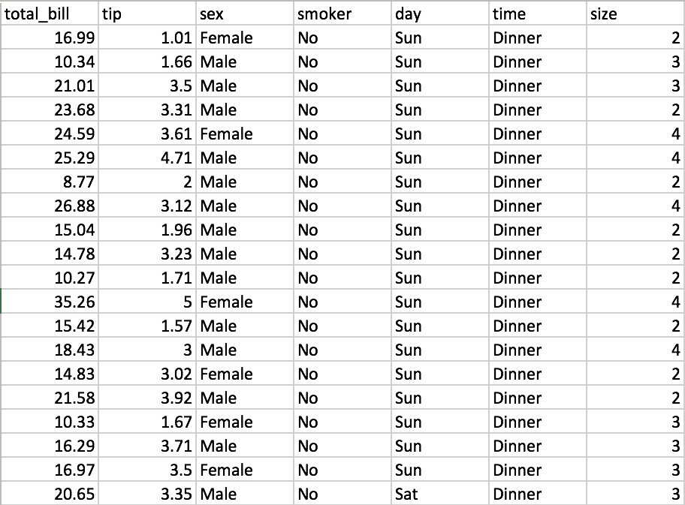
Seaborn – regplot()
Regression plot example
Take a look at the tips.csv dataset (used in example below)

Slide 37
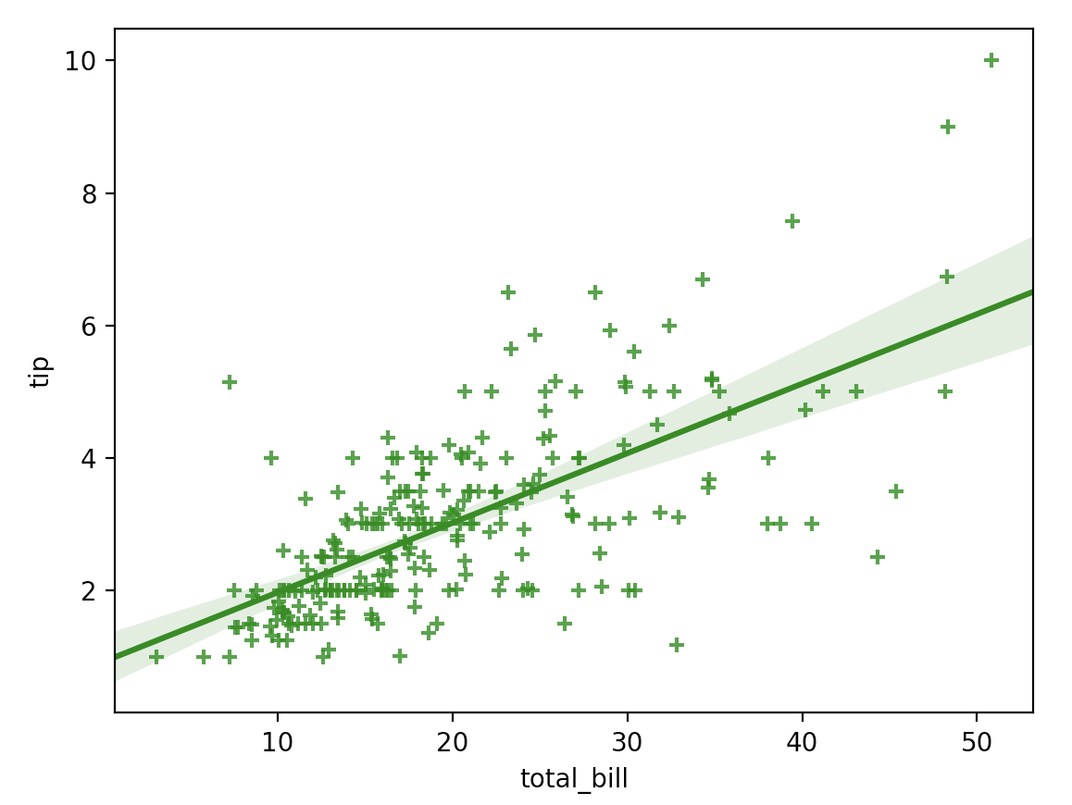
Seaborn – regplot()
Regression plot example
import numpy as np
import matplotlib.pyplot as plt
import seaborn as sns
import pandas as pd tips = sns.load_dataset("tips") sns.regplot(x="total_bill", y="tip", data = tips, color="g", marker="+")
plt.show()

Slide 38
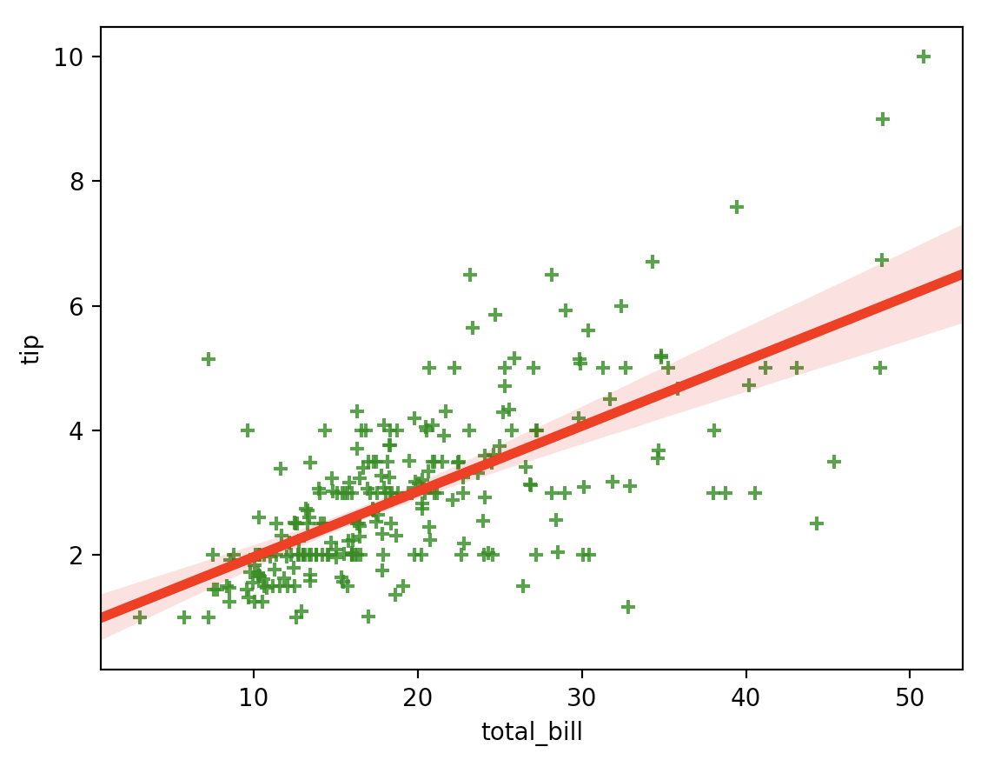
Seaborn – regplot()
Regression plot example
import numpy as np
import matplotlib.pyplot as plt
import seaborn as sns
import pandas as pd tips = sns.load_dataset("tips") sns.regplot(x = "total_bill", y = "tip", data = tips, marker = "+", scatter_kws = {"color" : "green"}, line_kws = {"color" : "red", "linewidth" : 4}) plt.show()

Slide 39
Seaborn Heatmap
import matplotlib.pyplot as plt
import seaborn as sns
sns.set()
f, ax = plt.subplots(figsize=(9, 6))
sns.heatmap(flights, annot=True, fmt="d", linewidths=.5, ax=ax)

Slide 40
Seaborn time series plot
# Plot the response with standard error
sns.tsplot(data=gammas, time="timepoint", unit="subject”
condition="ROI", value="BOLD signal")

Slide 41
ggplot
Pandas
Matplotlib
Seaborn
➔ ggplot

Slide 42
Ggplot
Pandas
Matplotlib
Seaborn
Ggplot
Statistical Graphs

Slide 43
gplot
ggplot package is a very popular graphics package
Based on ggplot2 package in R
Provides very readable graphics
Has a ‘grammar’ to describe graph
Excels at graphing complex data sets
Mastering ggplot can be ‘challenging’ ☺
Recommended book : “ggplot2: Elegant Graphics for Data Analysis”
http://www.ling.upenn.edu/~joseff/rstudy/summer2010_ggplot2_intro.html

Slide 44
Ggplot
The “ggplot” package is a very popular graphics package
Based on ggplot2 package in R
Provides very readable graphics
Has a certain grammar to describe graph
Excels at graphing complex data sets
Mastering “ggplot” can be ‘challenging’ ☺
Recommended book : “ggplot2: Elegant Graphics for Data Analysis”
http://www.ling.upenn.edu/~joseff/rstudy/summer2010_ggplot2_intro.html

Slide 45
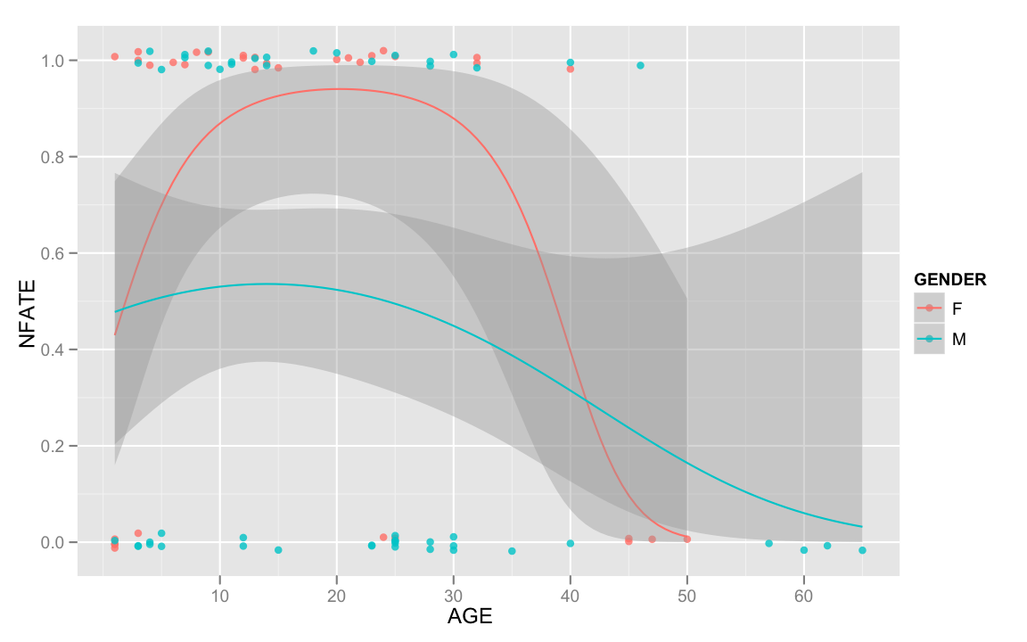
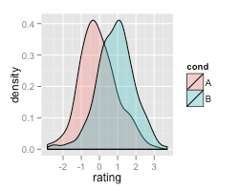
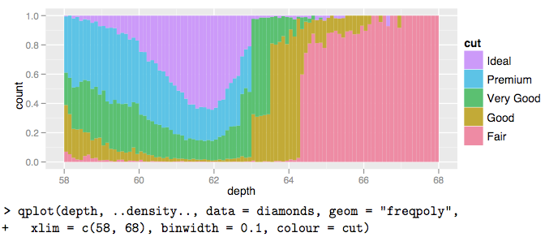
ggplot examples

Slide 46
Ggplot examples

Slide 47
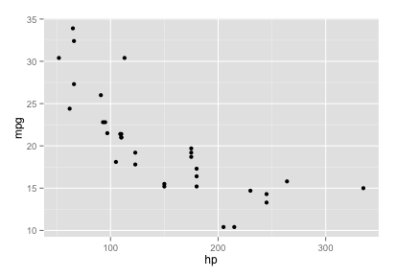
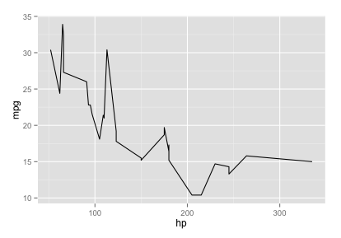
ggplot Quick Example
import ggplot ggplot(mtcars, aes(hp, mpg)) # Error: No layers in plot
# add a layer ggplot(mtcars, aes(hp, mpg)) + geom_point() # try a different layer ☺ ggplot(mtcars, aes(hp, mpg)) + geom_line()

Slide 48
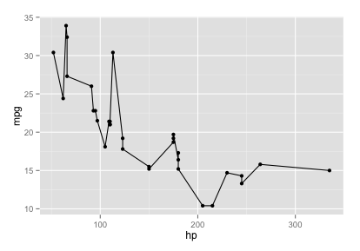
ggplot Quick Example: Layers
g = ggplot(mtcars, aes(hp, mpg)) g # Error: no layers
# add a layer g = g + geom_point() g # wow!
# add another layer g = g + geom_line() g # ☺

Slide 49
ggplot Syntax
ggplot (data, aesthetics, layers)
Data: data frame, vector, etc.
Aesthetics (aes)
Maps how elements get converted to graph
X position / x-y position / shape / color
Layers
Geometric shapes
Points / lines / bars

Slide 50
Ggplot – general syntax
Syntax
Involves Data, Aesthetics and Layers
ggplot (data, aes, layers)
data
can be DataFrame, vector, etc.
aes
Maps how elements get converted to graph
x position / x-y position / shape / color
layers
Geometric shapes
Points / lines / bars

Slide 51
Ggplot point and line plots
Quick example of point and line plots:
import ggplot ggplot(mtcars, aes(hp, mpg)) #Error: No layers in plot ggplot(mtcars, aes(hp, mpg)) + geom_point() #point layer ggplot(mtcars, aes(hp, mpg)) + geom_line() #line layer

Slide 52
Ggplot point and line plots
Same example of point and line plots (w/ variable assignment)
import ggplot g = ggplot(mtcars, aes(hp, mpg)) #Error: No layers in plot g1 = g + geom_point() #point layer g2 = g + geom_line() #line layer

Slide 53
Lab: Graphs / ggplot-qplot
Lab
Overview: Exploring graphing with Python
Approximate time: 30 minutes
Instructions :
9.3-ggplot1.md (qplot)
9.4-ggplot2.md (ggplot)

Slide 54
Lab: Graphs / ggplot-qplot
Lab
Overview: Exploring graphing with Python
Approximate time: 30 minutes
Instructions :
9.3-ggplot1.md (qplot)
9.4-ggplot2.md (ggplot)

Slide 55
Statistical Graphs
Pandas
Matplotlib
Seaborn
Ggplot
Examples
Statistical Graphs

Slide 56
Statistical Graphs
pandas
matplotlib
seaborn
ggplot
Statistical Graphs

Slide 57
Visualizing Data
Method | Description
Boxplot | A quick way to visualize the data
Frequency table | Count number of data points that fall into intervals (bins)
histogram | Plot of frequency table
Density plot | Smoothed version of histogram. (Kernel Density Estimate)

Slide 58
Visualizing Data
Method | Description
Boxplot | A quick way to visualize the data
Frequency table | Count number of data points that fall into intervals (bins)
Histogram | Plot of frequency table
Density plot | Smoothed version of histogram. (Kernel Density Estimate)

Slide 59
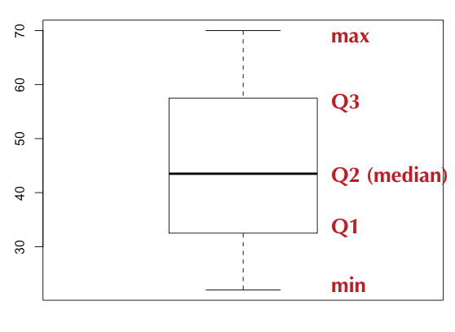
Boxplot / Box-and-Whisker Plot
Boxplot displays 5 measures : min, Q1, Q2 (median), Q3, max
Smallest / Largest values are measured within upper/lower fences
Fences are 1.5 times IQR
Income data (sorted): [22k, 25k, 30k, 35k, 40k, 42k, 45k, 50k, 55k, 60k, 65k, 70k]

Slide 60
Boxplot / Box-and-Whisker Plot
Boxplot displays 5 measures : min, Q1, Q2 (median), Q3, max
Q1, Q2, Q3 are the first, second and third quartiles
Smallest / Largest values are measured within upper/lower fences
Fences are usually 1.5 times IQR (Q3 – Q1)

Slide 61
BoxPlot : Sample Code (R)
income = c(22, 25, 30, 35, 40, 42, 45, 50, 55, 60, 65, 70)
bp = boxplot(income)
bp
$stats
[,1]
[1,] 22.0
[2,] 32.5
[3,] 43.5
[4,] 57.5
[5,] 70.0
$n
12

Slide 62
BoxPlot : Sample Code (Python)
%matplotlib inline import numpy as np import matplotlib.pyplot as plt salaries = np.array([22, 25, 30, 35, 40, 42, 45, 50, 55, 60, 65, 70]) plt.boxplot(salaries)

Slide 63
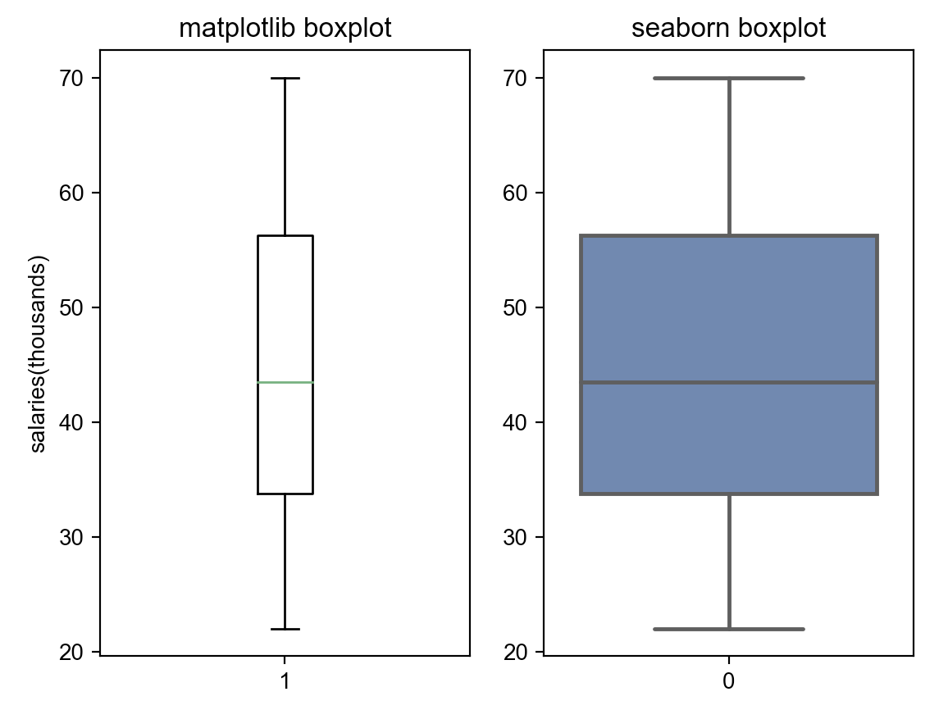
Boxplot / Box-and-Whisker Plot
Example: Boxplot for income data (sorted)
[22k, 25k, 30k, 35k, 40k, 42k, 45k, 50k, 55k, 60k, 65k, 70k]
import numpy as np
import matplotlib.pyplot as plt
import seaborn as sns
salaries = np.array([22, 25, 30, 35, 40, 42, 45, 50, 55, 60, 65, 70])
plt.figure()
plt.title("Boxplots")
plt.subplot(1, 2, 1)
m = plt.boxplot(salaries)
plt.ylabel("salaries(thousands)")
plt.title("matplotlib boxplot")
plt.subplot(1, 2, 2)
sns.set()
s = sns.boxplot(data = salaries)
plt.title("seaborn boxplot")
plt.show()

Slide 64
Histogram (R)
Histogram counts data points per bin
income = c(22, 25, 30, 35, 40, 42, 45, 50, 55, 60, 65, 70)
hist(income)

Slide 65
Histogram (Python)
Histogram counts data points per bin
%matplotlib inline import pandas as pd import numpy as np import matplotlib.pyplot as plt salaries = np.array([22, 25, 30, 35, 40, 42, 45, 50, 55, 60, 65, 70]) plt.hist(salaries, rwidth=0.7)

Slide 66
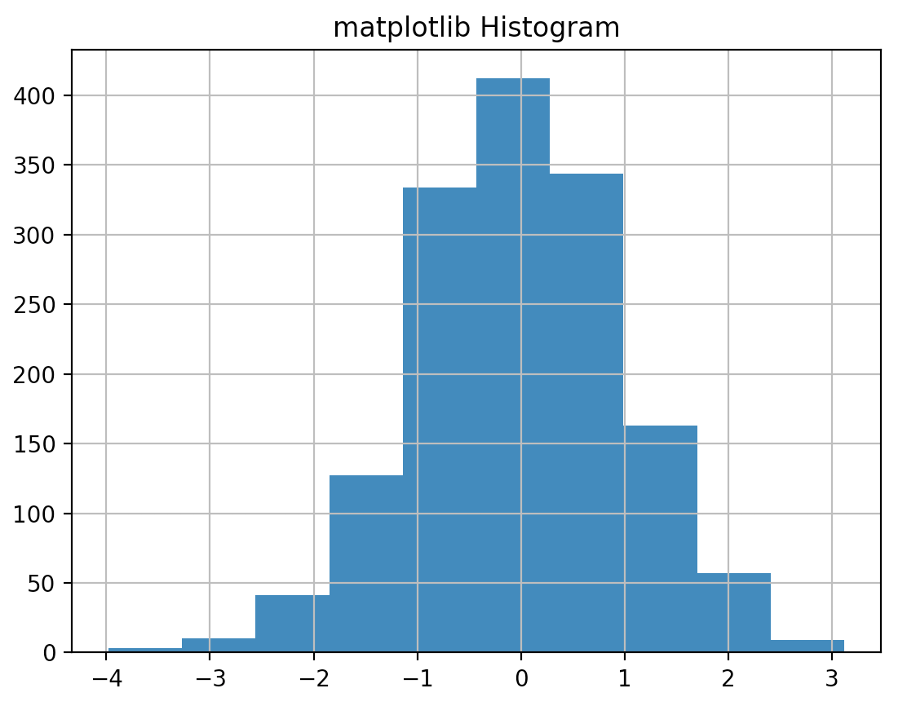
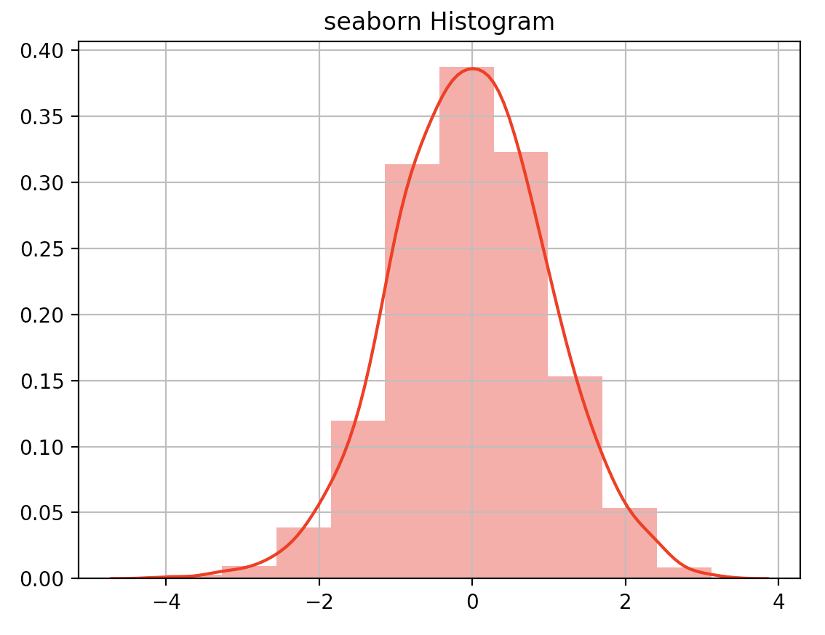
Histograms
Example: Histogram for np.random.randn() data
import numpy as np
import matplotlib.pyplot as plt
import seaborn as sns
num = np.random.randn(1500)
plt.figure()
# plt.title("Histograms")
# plt.subplot(2, 1, 1)
m = plt.hist(num, bins=10)
plt.grid(True)
plt.title("matplotlib Histogram")
plt.figure()
# plt.subplot(2, 1, 2)
s = sns.distplot(num, color = "r", bins = 10)
plt.grid(True)
plt.title("seaborn Histogram")
plt.show()

Slide 67
Scatter Plot (Python)
Histogram counts data points per bin
%matplotlib inline import numpy as np import matplotlib.pyplot as plt bills = np.array([50,30,60,40,65,20,10,15,25,35]) tips= np.array([12,7,13,8,15,5,2,2,3,4]) plt.xlabel("bill amount") plt.ylabel("tip") plt.scatter(bills, tips)

Slide 68
Examples
Pandas
Matplotlib
Seaborn
Ggplot
Statistics
Examples

Slide 69
Bar Plots: Matplotlib
Example of a barplot
fig, ax = plt.subplots()
rects1 = ax.bar(ind, men_means, width, color='r’,yerr=men_std)
rects2 = ax.bar(ind + width, women_means, width, color='y’, yerr=women_std)
# add some text for labels, title and axes ticks
ax.set_xticks(ind + width / 2)
ax.legend((rects1[0], rects2[0]), ('Men', 'Women'))

Slide 70
Barplot: Seaborn
Seaborn is easier!
ax = sns.barplot(x="day", y="total_bill", hue="sex", data=tips)

Slide 72
Lab: matplotlib - intro
Lab
Overview: Intro to matplotlib
Approximate time: 10 mins
Instructions:
06__pythonVisualization | 6.1-matplotlibIntro.ipynb

Slide 73
Lab: matplotlib - cars
Lab
Overview: Learn matplotlib and seaborn by exploration of the cars dataset
Approximate time: 20 mins
Instructions:
06__pythonVisualization | 6.2-matplotlibCars.ipynb

Slide 74

Review

